Slide 1
Swing-up Control of a Robot Arm
ECE4122 – Control System Design Project
Kuan Hou Lee – 25952625
Eric Horng – 26935449

Slide 2
Order of Presentation
Introduction
Goals
Conclusion
Notes:
Tell them what you’ll be taking about
Introduce the project
Talk about how we achieved each goal
Quick conclusion on our findings/reflection

Slide 3
Introduction
Control systems are everywhere
Vital for future Electrical Engineers to learn
Controlling a robot arm
Notes:
- Ranging from cruise control system on your car to large industrial control systems
As budding electrical engineers, we need to know how to design them
For this project, we were tasked to control a robot arm

Slide 4
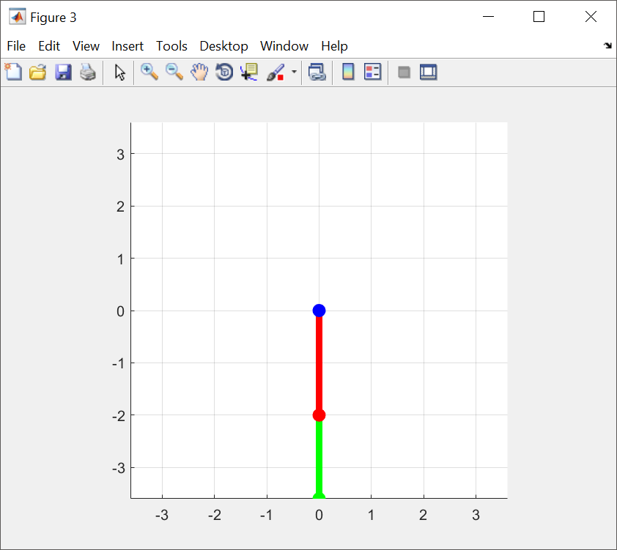
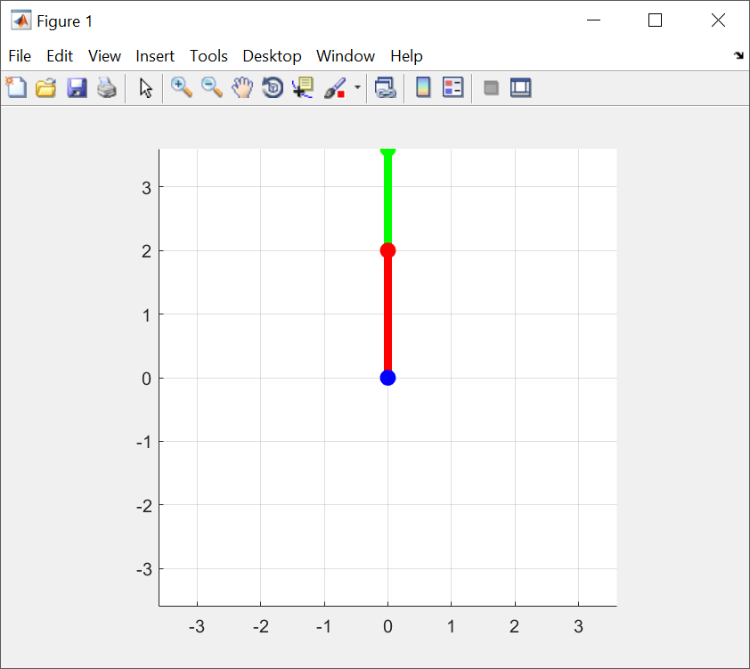
Aim
Notes:
Constraints
Requirements

Slide 5
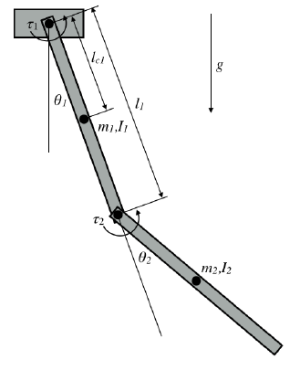
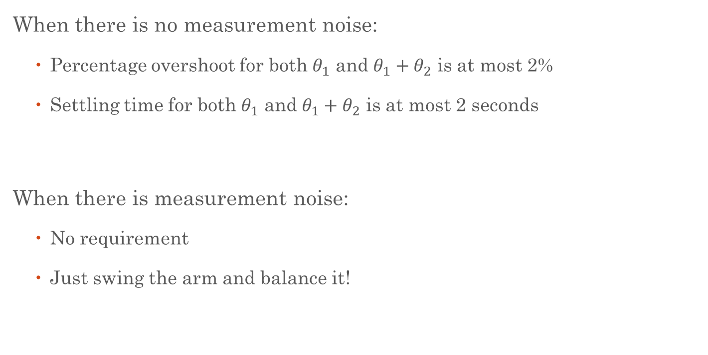
Requirements
When there is no measurement noise:
Percentage overshoot for both $θ_{1}$ and $θ_{1}+θ_{2}$ is at most 2%
Settling time for both $θ_{1}$ and $θ_{1}+θ_{2}$ is at most 2 seconds
When there is measurement noise:
No requirement
Just swing the arm and balance it!

Slide 6
Goal 1
Implement an ideal model of the system

Slide 7
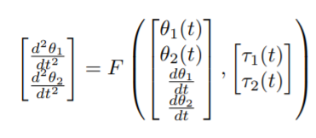
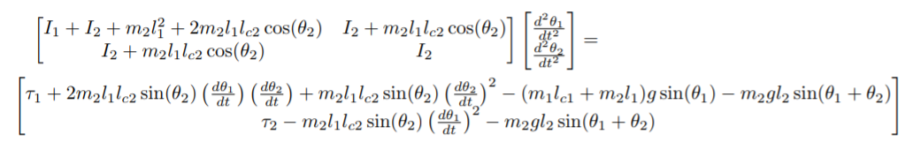
Goal 1
Obtain the function F from the differential model

Slide 8
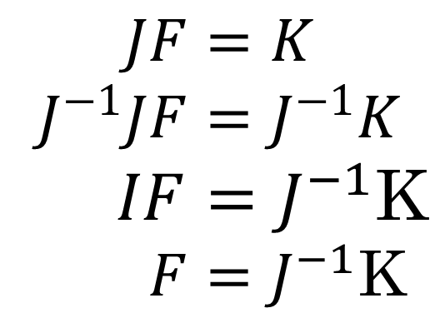
Goal 1
J
F =
K
$$JF=K \\ J^{−1}JF=J^{−1}K \\ IF=J^{−1}\text{K} \\ F=J^{−1}\text{K}$$

Slide 9
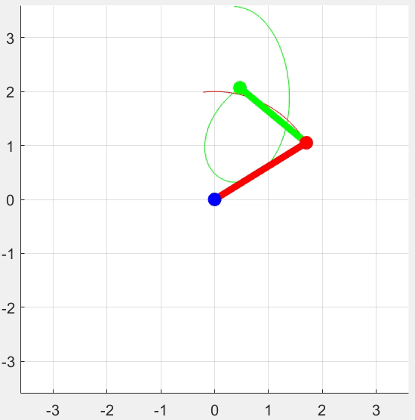
Goal 1
Implement the Fmy_planar_robot function

Slide 10
Goal 2
Identify the mass of the first pendulum

Slide 11
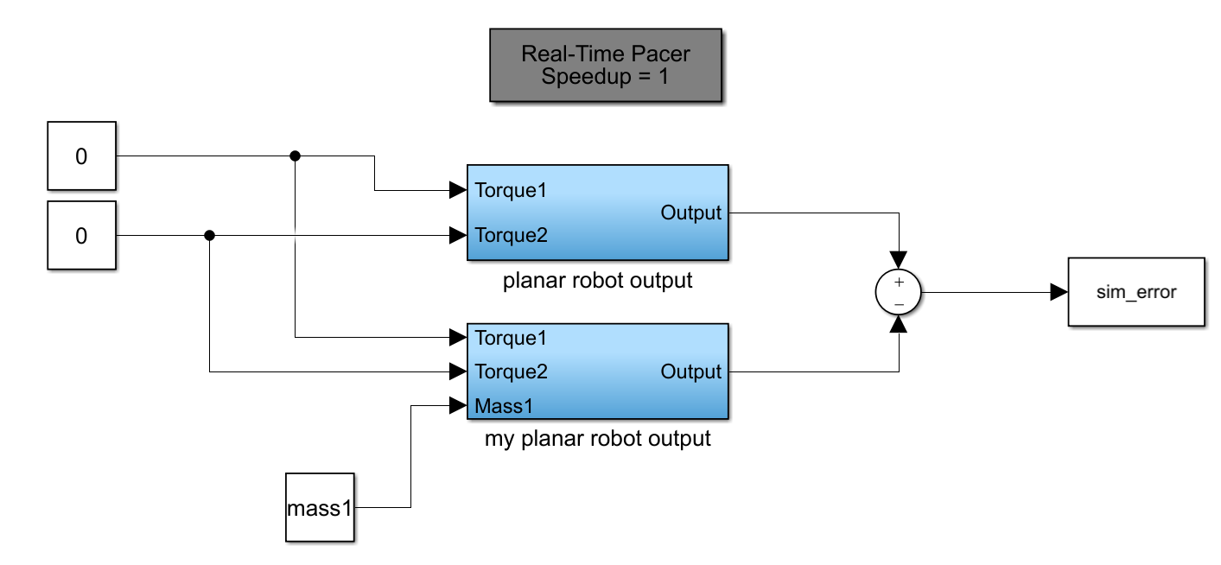
Goal 2
Add appropriate input signals to both models
Find estimated mass with minimal error value
Notes:
Used least squares parameter estimation method

Slide 12
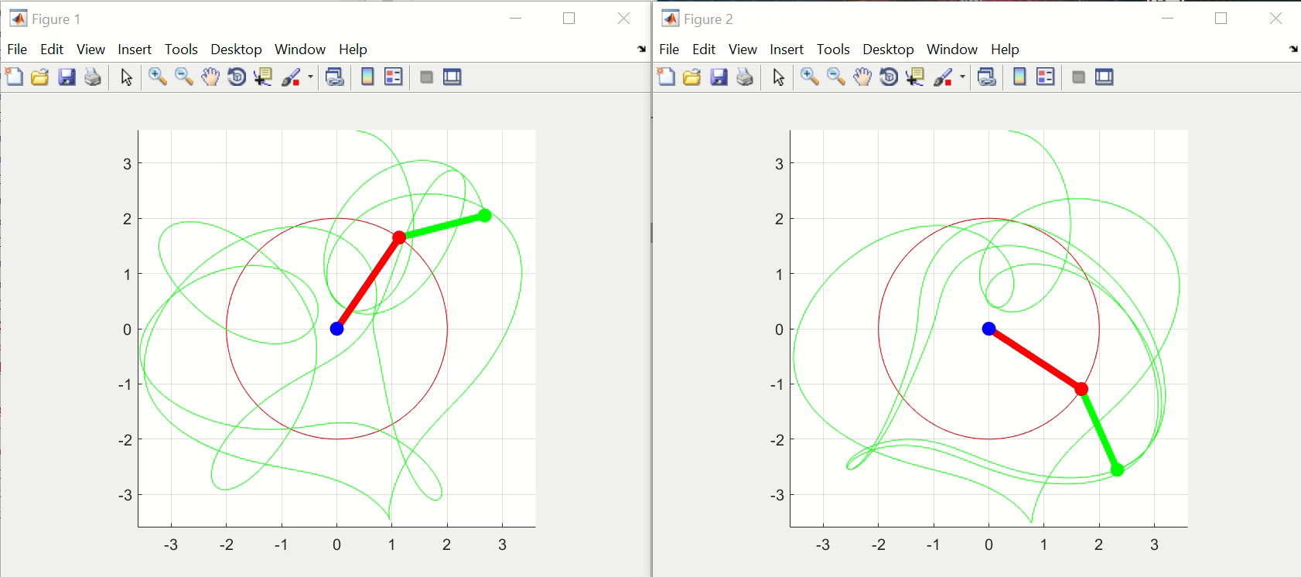
Goal 2
Initial run-through
Initial position at upwards vertical position
Error values had no correlation to estimated mass value

Slide 13
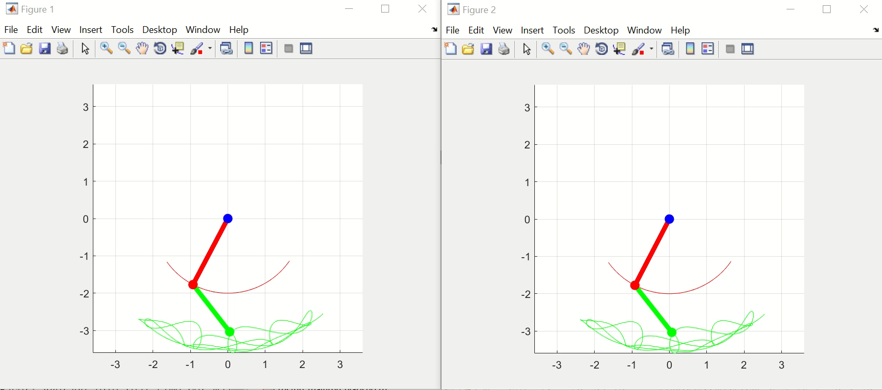
Goal 2
Lower initial position
Shortened simulation runtime (10 seconds)
Minimise amount of pendulum movement
Mass = 0.66283kg

Slide 14
Goal 3
Continuous-time full-state control design for ideal model

Slide 15
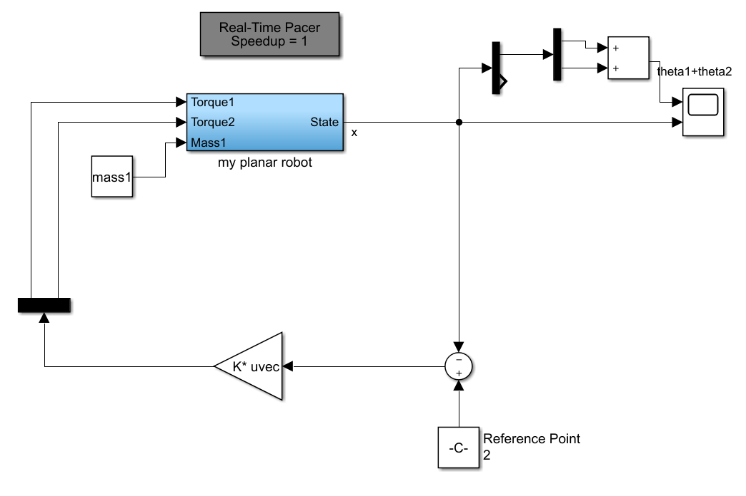
Goal 3
Controller

Slide 16
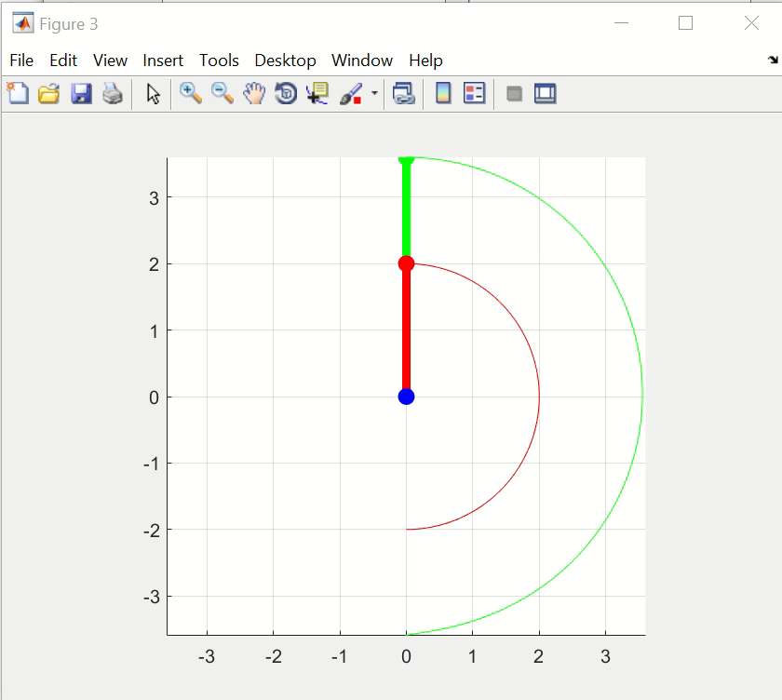
Goal 3

Slide 17
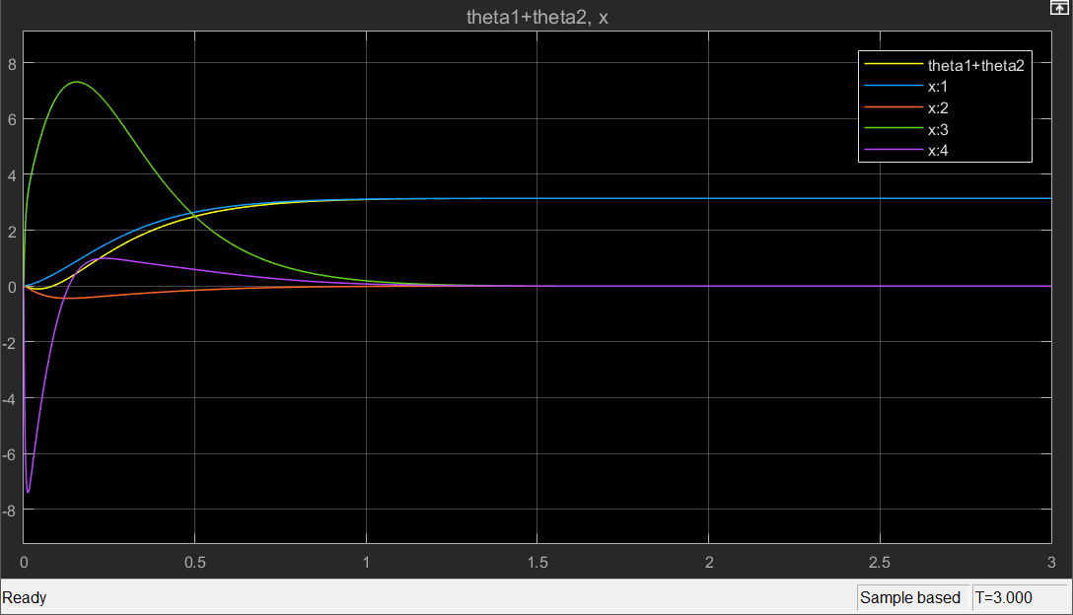
Goal 3
System response

Slide 18
Goal 3
Poles and Zero plot of the system
Notes:
- Poles in left hand side of plane (continuous-time)
- Used LQR method to get best placement of eigenvalues

Slide 19
Goal 4
Discrete-time full-state control design for ideal model

Slide 20
Goal 4
Use c2d MATLAB function to convert continuous sys object to discrete.
Kept the feedback loop the same.
Converted eigenvalues eigD=exp(eigC*T) were not stable in new system. Had to find new ones.
Trial and error
Eig with parameter settling time=0.3 and % overshoot 0.02 stable and within project parameters

Slide 21
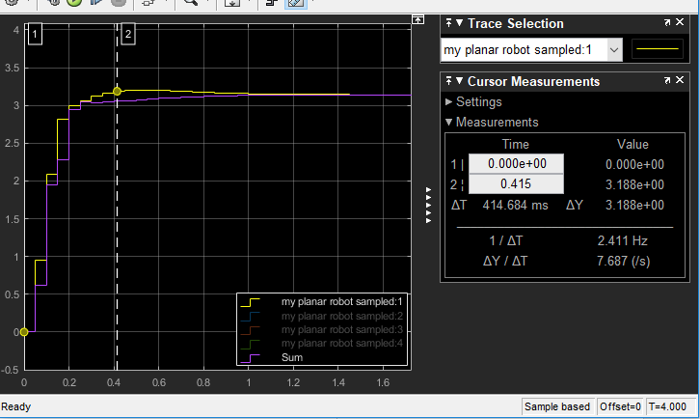
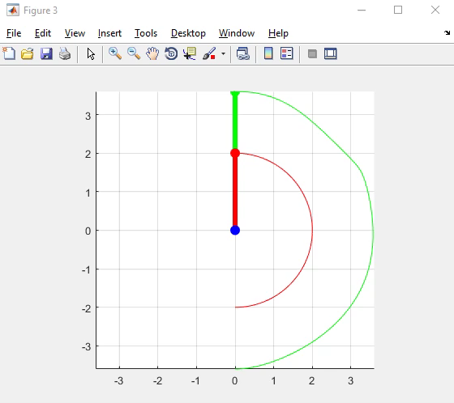
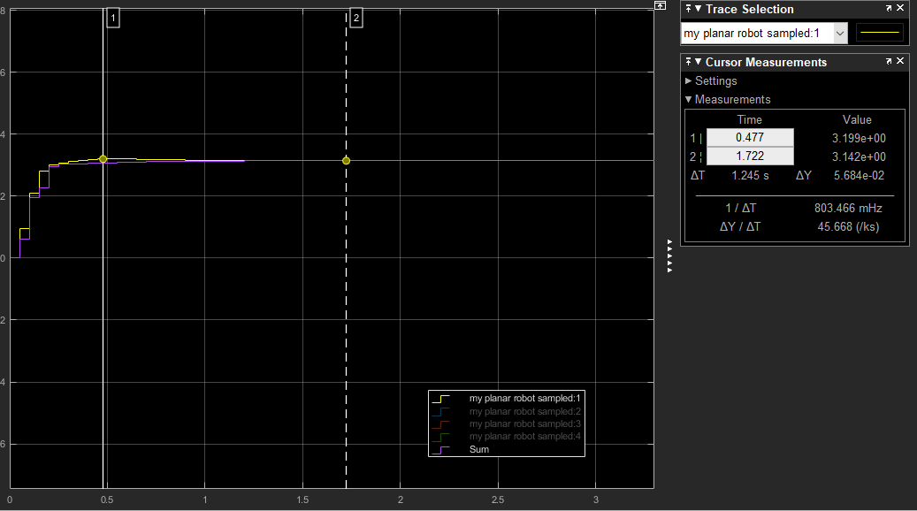
System Demo
2% Settling time within 2 seconds
Overshoot=1.78%

Slide 22
Goal 5
Evaluation of design on system

Slide 23
Goal 5
Tried noise reduction systems
Kalman filter
Moving average – Sliding window introduced delay proportional to window size
Integrating action
Realized biggest problem wasn’t noise but input saturation
Hard to find stable eigenvalues using previous method (trial and error given overshoot and settling time)
Solution: LQR to calculate feedback gains

Slide 24
Linear-Quadratic Regular (LQR) function
Keep feedback loop the same
Let MATLAB function lqrd calculate feedback gains instead of manually doing yourself
lqrd(A,B,Q,R,Ts)
Tune Q and R matrices to balance control effort and error
Trial and error
Returns K matrix of optimal feedback gains

Slide 25
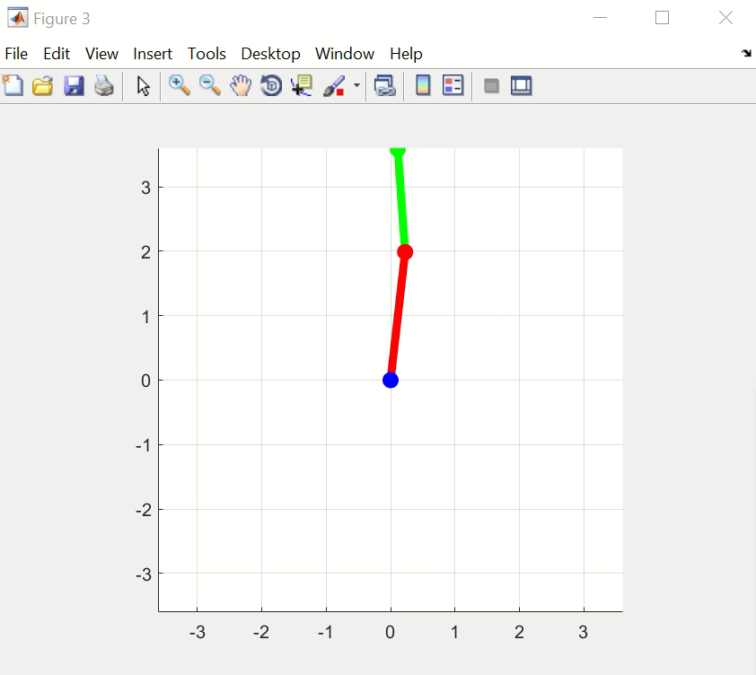
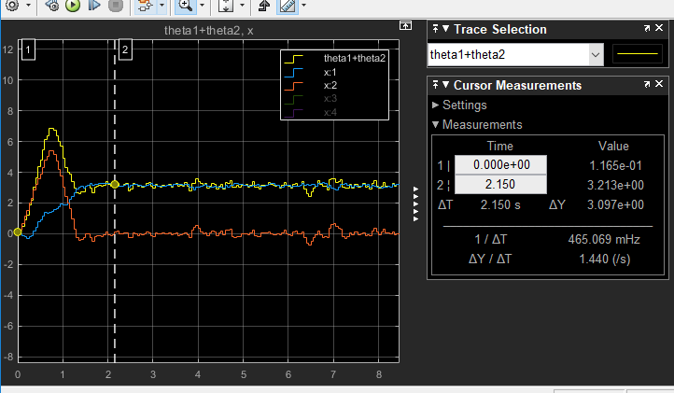
System Demo

Slide 26
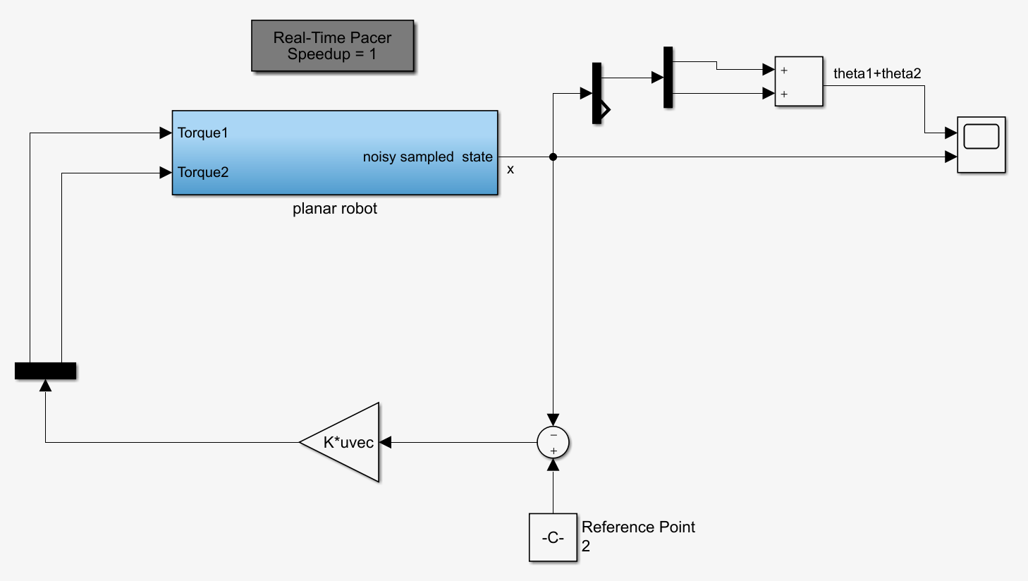
Goal 5 Controller

Slide 27
Additional Goals
Decrease sampling frequency
Tune Q and R to attempt to balance at upwards equilibrium point
Lowest sampling frequency discovered: 12.5 Hz

Slide 28
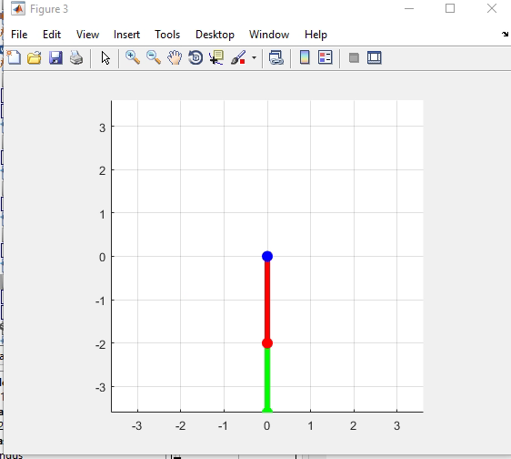
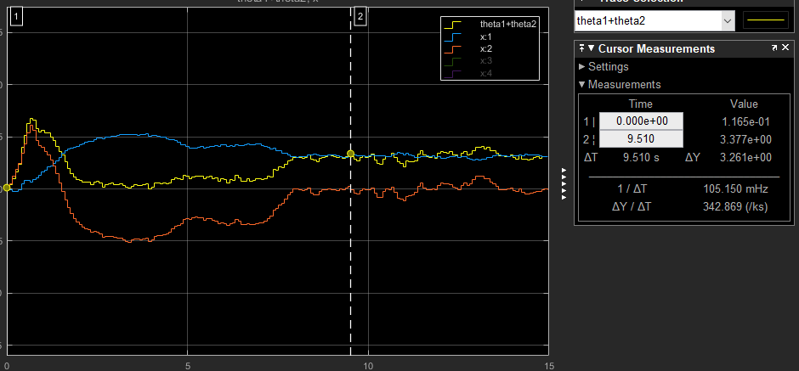
Sampling Demo

Slide 29
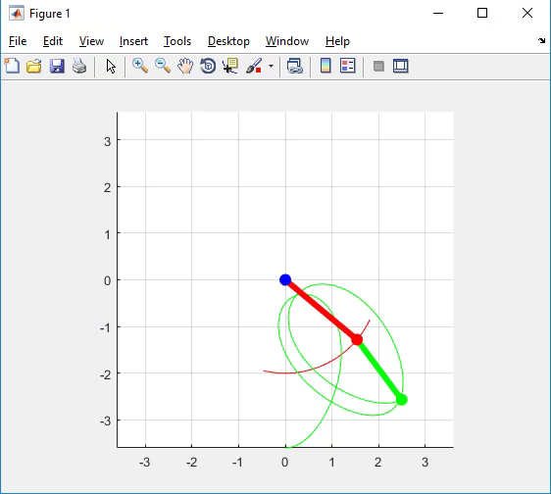
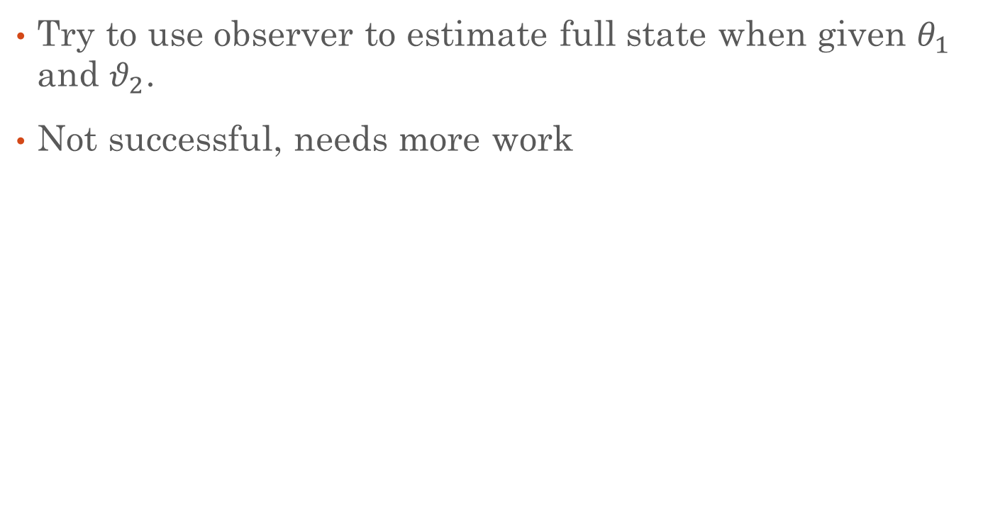
Additional Goals 2
Try to use observer to estimate full state when given $θ_{1}$ and $θ_{2}$.
Not successful, needs more work

Slide 30
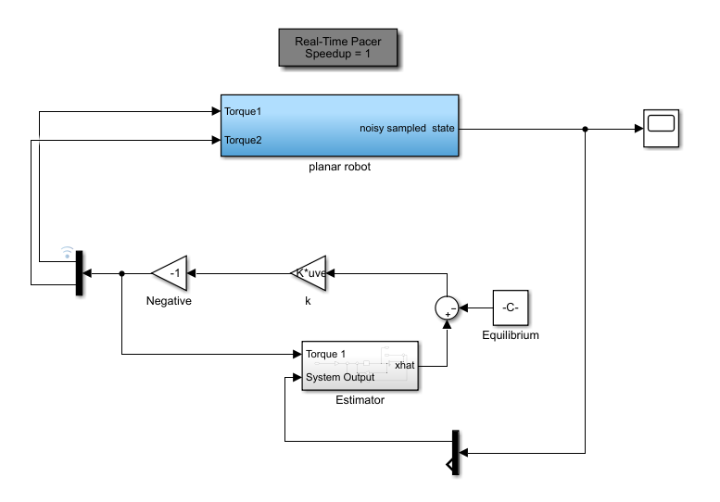
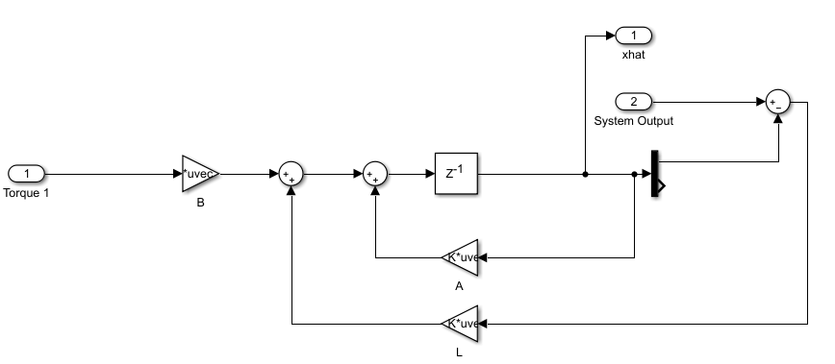
Observer Model

Slide 31
Conclusion/Reflection
Met all design specifications
Completed one additional goal
Smaller sampling time
Most difficult part was finding stable eigenvalues
Use LQR
Trial and error (Time)
Wish we knew MATLAB can do partial differentiation instead of wasting time doing by hand

